Slide 1
Strengthening data systems by modernising the production and use of agricultural statistics: informing policies with a view to improving resilience in agriculture, nutrition and food security in Africa
Ms. M. Dookhan
FAREI

Slide 2
Agriculture in the local context
History and Evolution of Agriculture
The sugar cane industry has been the backbone of our economy until recently.
The agricultural sector of Mauritius comprise mainly of:
Crop Sector
Sugar cane
Tea
Food Crops
Orchards
Ornamentals
Livestock Sector
Poultry
Cattle
Sheep and Goats
Pigs
Deer
Food Processing Sector
Fisheries sector
D

Slide 3
Agriculture in the local context
Crop Sector
Area harvested and production - Island of Mauritius, 2019 - 2020
Crops | 2019 |  | 2020 ¹
 | Area harvested (hectares) | Production (tonnes) | Area harvested (hectares) | Production (tonnes)
Sugar cane | 45,054 | 3,405,250 | 43,711 | 2,620,874
Tea (green leaves) | 656 ² | 8,329 | 667 ² | 5,105
Foodcrops | 7,334 | 93,736 | 7,352 | 95,029
^{Source: Statitistics Mauritius} ¹ Provisional
² Area under cultivation

Slide 4
Agriculture in the local context
Livestock Sector
Number of cattle, goats, sheep and pigs by type of breeder as at December 2021 - Island of Mauritius
^{Source: FAREI}

Slide 5
Agriculture in the local context
Poultry
The Republic of Mauritius is self-sufficient in chicken meat and eggs
Yearly production:
47,500 t of chicken meat
12000 t of eggs (equivalent to 218.2 million units)
Number of birds and number of farmers as at December 2021
Source: FAREI
 | Broilers | Layers
No. of farmers | 354 | 145
No. of Birds | 1,944,968 | 557,376

Slide 6
Agricultural Trade in the local context
Trade
Imports
The Rep. of Mauritius relies on imports of its staple food (rice, wheat), meat, milk and milk products, pulses and other cereals
Onion and Potato are imported during off season to cater for market demand
Self sufficiency of food is below 30%
Exports
Sugar is a main agricultural export (368,407 t)
Other exports include: wheat flour (10,167 t), fish (83,617 t), pineapple (1,228 t) and other fruits (238 t)
Self-sufficiency
The Republic is self-sufficient in most fresh vegetables
Local Fruits: Banana, pineapple, watermelon
Chicken and Venison; eggs.

Slide 7
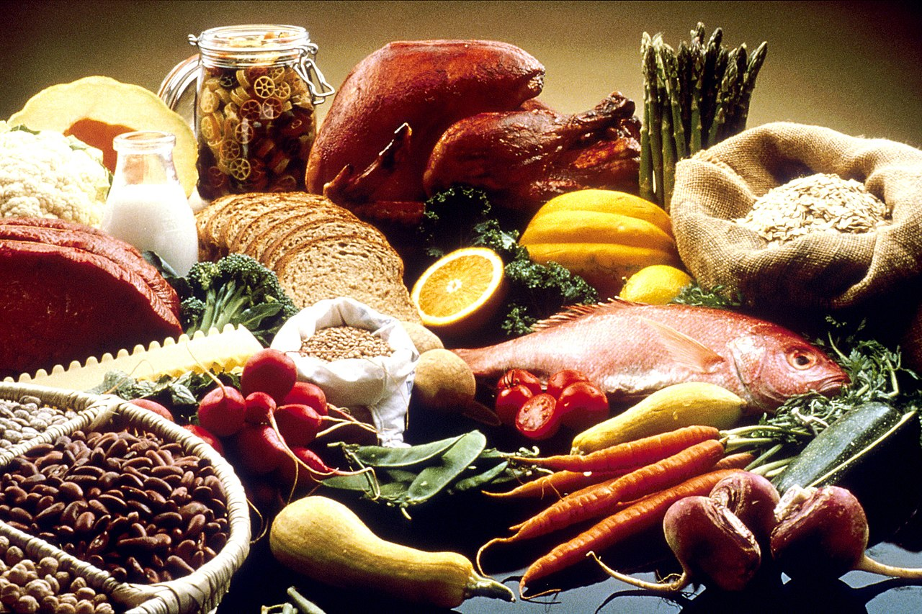
Food Security at a glance

Slide 8
Food Security at a glance
“Food security exists when all people, at all times, have physical and economic access to sufficient, safe and nutritious food that meets their dietary needs and food preferences for an active and healthy life” – (World Food Summit, 1996)
The right to food was first recognized in the UN Declaration of Human Rights in 1948
For food security to exist, the following conditions should be met:
Food Availability
Food Access
Utilisation of food
Stability

Slide 9
Food Security for the Republic of Mauritius
The state of Mauritius should cater for food security for:
A population of around 1.3 million
The visitors
Prior to the COVID-19 pandemic, there were around 1.4 million people visiting yearly and spending approximately 10 nights.

Slide 10
Importance of informed policies
Policy decisions are crucial to the achievement or maintenance of Food Security
Policy decisions should ‘most preferably’ be data-driven.
Statistical analysis can assist decision makers identify issues. Therefrom, appropriate measures can be taken.
Statistics analysis can be used as a forecasting tool. Decisions can be taken to avert or reduce a predicted negative impact.
Statistics can help in the monitoring and evaluation of policies. If need be, new or altered policies/schemes/grant could thus be developed.

Slide 11
Importance of informed policies
Good Statistics can enhance the decision making process as regards to:
New schemes (e.g. encouraging production of specific crops)
Release of land for crop/livestock production
Importations to cater for low market supply
Storage facilities
Transformation and preservation of agricultural products

Slide 12
How can agricultural statistics help to combat food insecurity?
Agricultural statistics are crucial to inform decisions that will drive a more sustainable agriculture.
These are the necessary qualities of Agricultural Statistics:
Timeliness
Accuracy
Reliability
They are key to:
Enhance productivity
Decrease food loss and waste
Forecast food shortages, crisis
Informed decision making for imports
Combat malnutrition

Slide 13
How can agricultural statistics help to combat food insecurity?
Productivity can be enhanced by making available:
Yield data
Data on diseases/disease resistance
Meteorological data
Soil fertility data
New techniques of production (e.g. vertical farming)
Cost of production data
A decrease in Food loss/ waste is possible by making available:
Pest and disease surveillance data
New plantation data (to reduce glut)
Market information data
Forecast on food shortages can be worked out based on:
Field survey data
Remote sensing data (satellite or drone)

Slide 14
Data users
Class of users of Agricultural Statistics:
Institutions and Authorities
Decision makers
Farmers
Other Stakeholders
Capacity building of data users as regards to data interpretation is important

Slide 15
Statistics at Institutional level
Data are produced by different institutes and by different sectors mainly for their own use
Essential statistics from different institutions and sectors are published by Statistics Mauritius
Strengthening data system involve cooperation between different institution

Slide 16
Stakeholders of interest
Stakeholders of interest that cut across the different sectors
The MAIFS and other bodies falling under its purview
FAREI
Agricultural Services
Mauritius Meat Authority
Ministry of Blue Economy, Marine Resources, Fisheries and Shipping
The Mauritius Meteorological Services
Statistics Mauritius
The Mauritius Chamber of Agriculture
The MCIA & The MSIRI
Ministry of Environment
Ministry of Finance

Slide 17
Partnershipfor data-driven decisions
A need for more cooperation between stakeholers
Statistics Mauritius is the local coordinator for statistics
Cooperation between institutions generating statistics is essential for national benefit
Benefits of cooperation include:
Access to new data sources
Increased efficiency
Supporting data-driven decision-making towards the goal of food security

Slide 18
Data of interest
Crucial data needed in Agricultural statistics to support Food Security include (but is not limited to):
Climate data
Pest and Disease surveillance data
Vulnerability assessment data
Market data
Land use data
Soil fertility data
Health care data (e.g. rate of chronic diseases, obesity, malnutrition in population)
Government schemes

Slide 19
Improving Resilience in Agriculture
Ways of improving resilience in Agriculture:
Provide timely and evidence-based food security and livelihood information and analysis
Targeting of vulnerable groups
Identify needs of the targeted population and providing support needed
Provide statistical support in areas such as survey design, sampling techniques and information management (data collection, data management, analysis and dissemination)
Increase granularity of data
Capacity building for data users and data producers
Expand the capabilities of partners engaged in food security
Raise awareness on food security situation

Slide 20
Modernising the production and use of Agricultural Statistics
Modernising data collection and production of agricultural statistics
Use of the likes of smart phones and tablet for data collection purposes
Using new technological improvements (e.g. remote sensing) to collect data.
The integration of data from different sources (e.g. survey data vs. master sampling frames, big data etc.),
Using GIS technologies to visualise field data on a map
Using Big Data to reveal patterns, trends, and associations amongst others. They are mostly used in developed countries due to their complexities.
Producing new indicators in response to the growing demand by policy-makers and decision makers for statistics based information that is interlinked in different aspects – agricultural, social, economical, environmental, etc.

Slide 21
Modernising the production and use of Agricultural Statistics
Application of the modern technologies can help in:
Digitalising data and creating of repositories
Dissemination of information and raising of awareness
Providing support to vulnerable groups and vulnerable farmers
Identifying, quantifying and monitoring vulnerable regions (mountain flanks, flood prone regions)
Raise awareness on food security situation
Planning of production to high accuracy using modern techniques of production thus avoiding market glut.

Slide 22
Concluding Remarks
Modern agriculture will become more significant in the future to feed the nation and this can be facilitated through enhancing our agricultural statistics system for better production with optimal cost to serve market demand.

Slide 23
Thank you!

